Slide 1
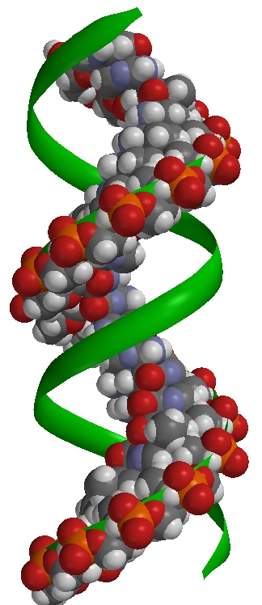
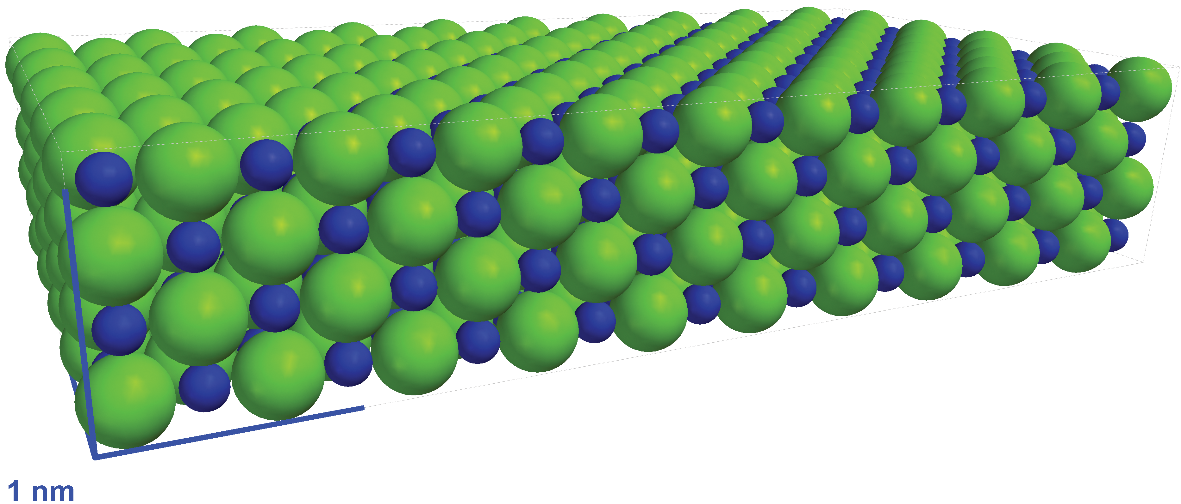
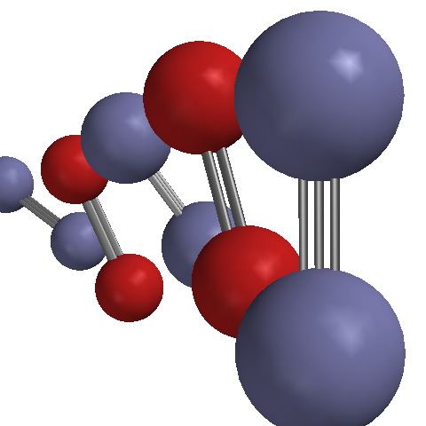
Working with
Wavefunction, Inc.
18401 Von Karman Ave #435
Irvine, California 92612
support@wavefun.com

Slide 2
In This Document
What Is Unique About ? 3
How Can Be Used? 4
Input Functions — Trackpad / Mouse / Touchscreen 5
Visualization — Model Styles and Other Display Options 10
Dynamics — Initiating and Controlling Simulations 16
Building — From Molecules to Simulation Cells 20
Comparing — Showing Models Side-by-Side 29
Scientific Content — New Users / Labs / Stockroom 35

Slide 3
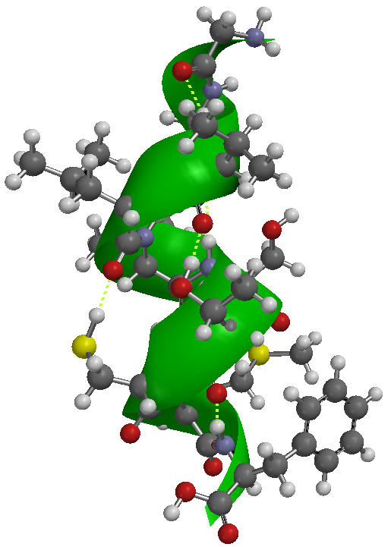
What Is Unique About
?
3D Visualization & Simulation
that is…
…at the molecular level Always!
(Models are generally “realistic”
representations of structure and dynamics)
…science-based Always!
(Program is closely related to research-grade
molecular modeling software)
…explorable Always!
(On-the-fly computation allows
for open-ended experiments)

Slide 4
How Can
Be Used?
Direct Demonstrations
“The Molecular Perspective”
Inquiry/Exploration
Ask Leading Questions, Follow Up with Model!
Computer Lab Experiments
Complement to Wet Labs
Take-Home Labs
Homework Assignments
Enrichment
Self-Study
Lecture
Laboratory
Student
Computers

Slide 5
User Input Functions
Trackpad / Mouse / Touchscreen

Slide 6
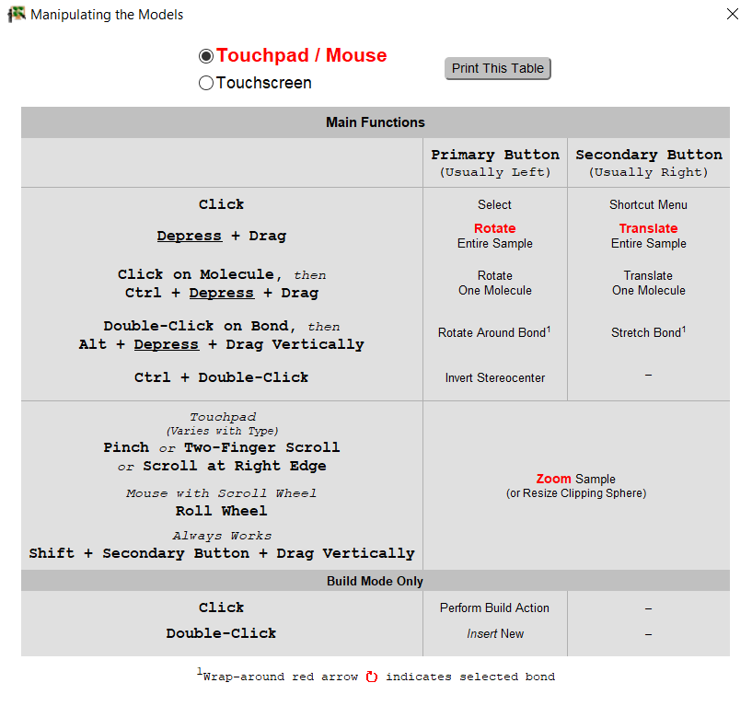
How Do I Manipulate the Models?
Help Menu
Dialog is tailored (!)
for Windows/Macintosh

Slide 7
Main 3D Functions
Drag (Touchscreen)
Left Button + Drag (Trackpad / Mouse)
Rotate
Translate
Zoom
Long Press + Drag (Touchscreen)
Right Button + Drag (Win Touchpad / Mouse)
+ Button + Drag (Mac Trackpad)
Pinch (Touchscreen / Trackpad)
Scroll Wheel (Mouse)
Add’l options (especially for older computers):
Help menu → Touchpad/Mouse/Touchscreen Functions…

Slide 8
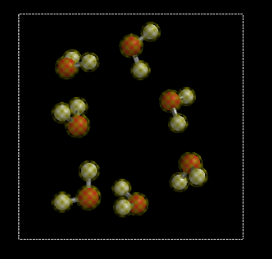
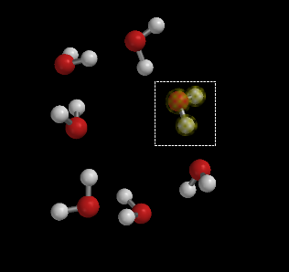
Models with Multiple Molecules
Rotate / Translate
Entire Model
( = All Molecules)
CTRL key not held down →
CTRL key held down →
Rotate / Translate
Selected
Molecule Only

Slide 9
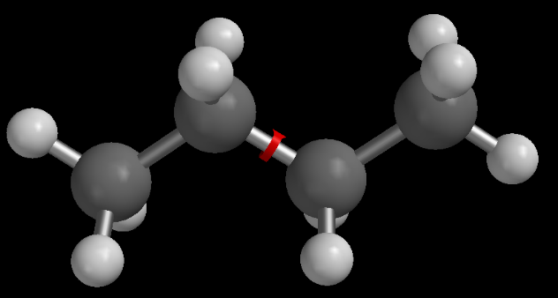
Manipulating a Selected Bond
Double-tap / double-click on bond to
select it (Red wrap-around arrow confirms selection)
ALT key not held down →
Rotate Model
Translate Model
ALT key held down →
Rotate Around Bond
Change Bond Length
Drag (Touchscreen)
Left Button + Drag
Long Press + Drag (Touchscreen)
Right Button + Drag
+ Button + Drag (Mac Trackpad)

Slide 10
Visualization
Model Styles and Other Display Options

Slide 11
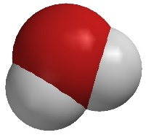
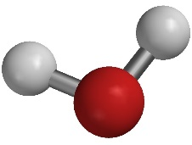
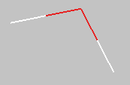
What Style Should I Choose?
Start with Space Filling — it shows what things “really look like”
Molecular shape
Packing in solids and liquids
Emptiness of gases
To see details, switch to Ball and Spoke (or Ball and Wire)
Covalent bonds
Distance / Angle measurements
Tube — very useful in conjunction with hydrogen bonds
Wire — useful for the solvent of solutions
→ Ball and Spoke is the default style for the build panels
→ Use Space Filling for gases…or you will hardly see anything !

Slide 12
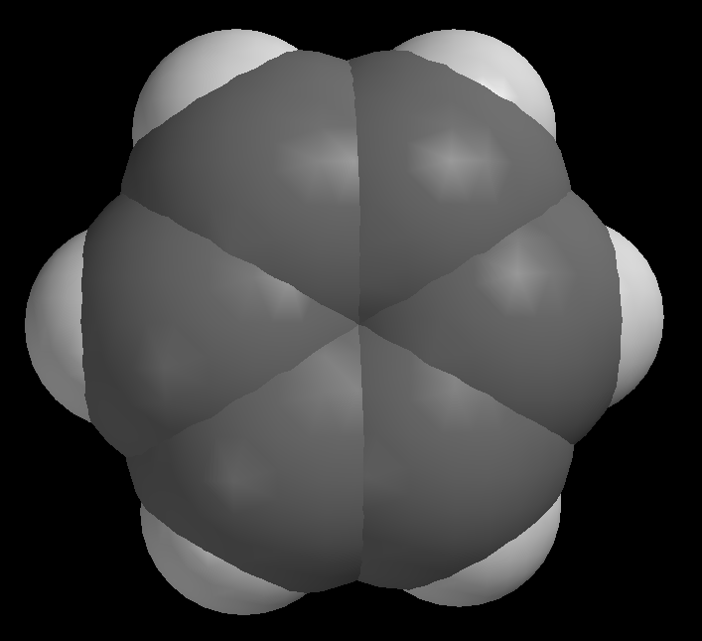
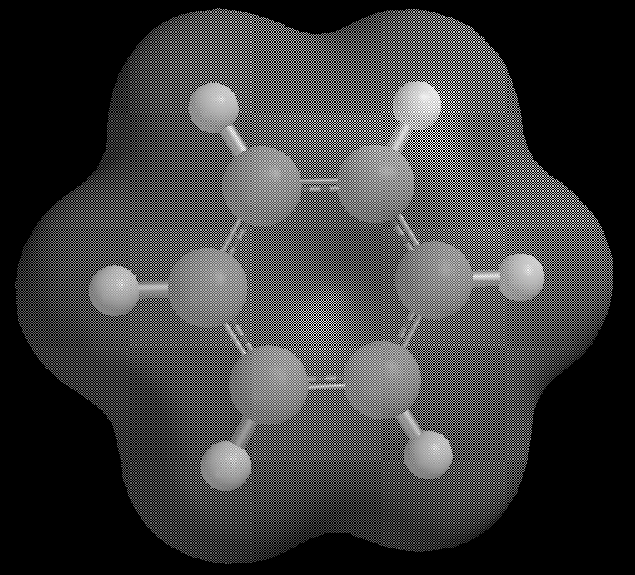
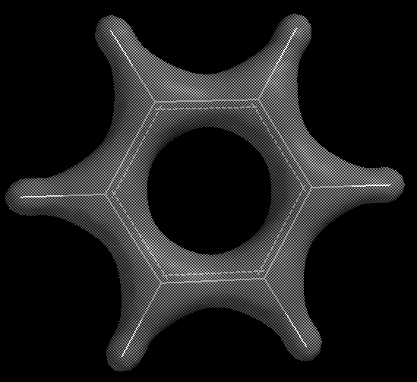
Visualization: Molecular Shape
Style → Space Filling
Approximate Shape
Electron Cloud → Low Density
True Shape
(~99% of the Total Density)
Electron Cloud → High Density
Emphasizes Covalent Bonds
(~50% of the Total Density)

Slide 13
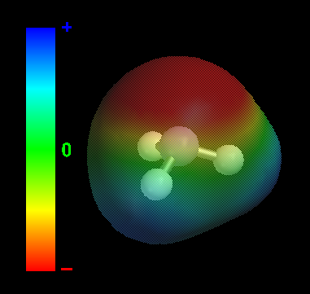
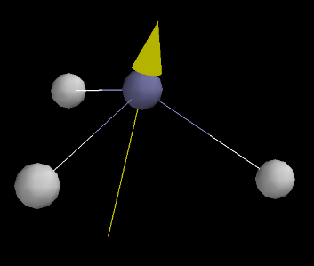
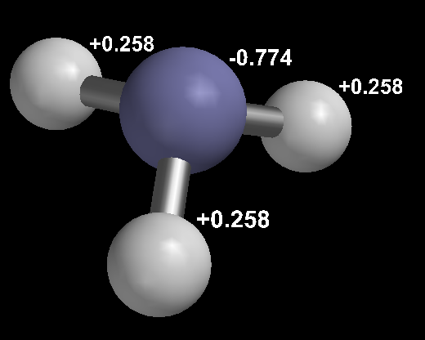
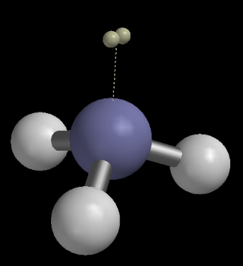
Visualization: Polarity
Electron Cloud → Polarity Map
(Low Density Isosurface; Color = Electrostatic Potential)
Style → Dipole Arrows
(Combine with Ball and Wire or Wire !)
Style → Charge Labels → Partial (Atomic)
Either Classical or Quantum Theory
Style → Lone Pairs
Cartoon (!) Representation

Slide 14
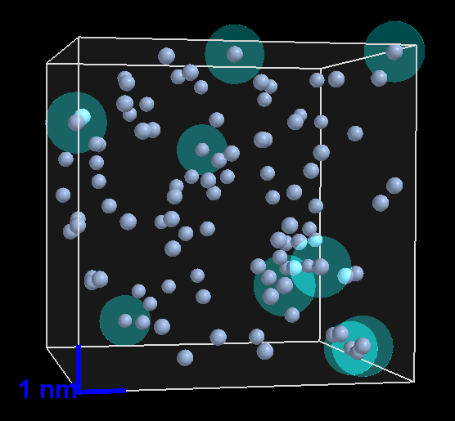
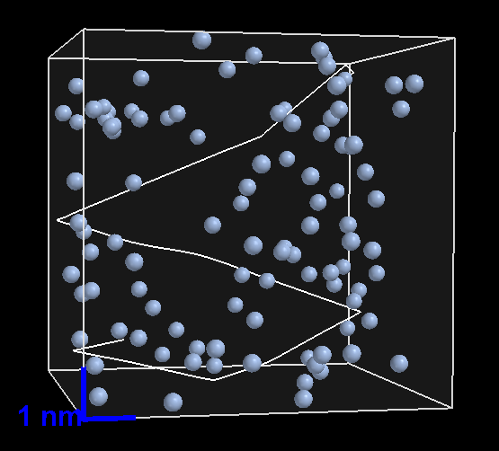
Visualization: Kinetic Theory of Gases
Style → Collisions → Particle-Wall
Concept of “Pressure”
Style → Trails → Long
(All Trails)
Right-Click on an Atom → Show Trail
(One Trail)

Slide 15
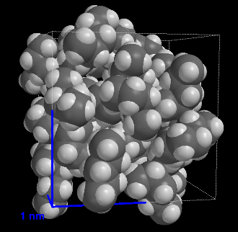
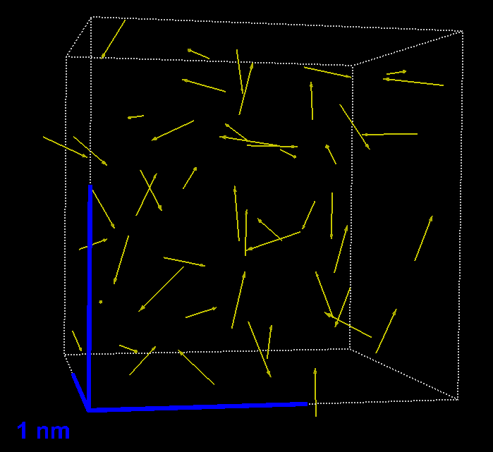
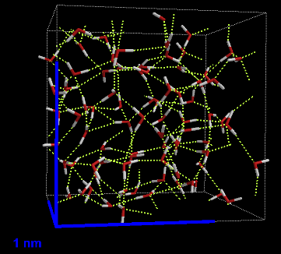
Visualization: Intermolecular Forces
Style → Space Filling
Illustration of Dispersion Forces
Style → Dipole Arrows
(Combine with Hide !)
Illustration of Dipole-Dipole Forces
Style → Hydrogen Bonds
(Combine with Tube !)
Illustration of Hydrogen Bonding Forces
C₅H₁₂ (l)
CH₂Cl₂ (l)
H₂O (l)

Slide 16
Dynamics
Initiating and Controlling Simulations

Slide 17
Molecular Dynamics
Slow / Fast
(Slider)
Go / Stop
(Toggle for
Continuous Simulation)
Step Back / Step Forward
(Step-by-Step)
~10⁻¹⁵ s (femtoseconds) ← Actual Molecular Time Step
(as assigned by the program)
Time Scale ~10⁻¹² s (picoseconds) ← Typical “Step-by-Step” Interval
~10⁻⁹ s (nanoseconds) ← Maximum Length of Simulations
(long simulations of minutes…hours duration)

Slide 18
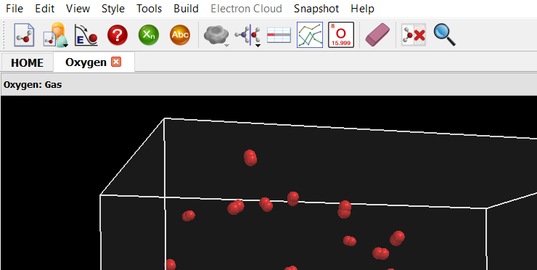
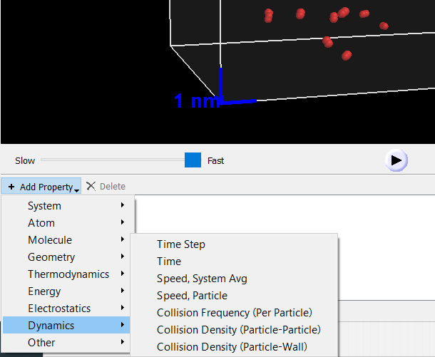
Controlling the Time Step Explicitly
Add Property…
(Lower Left Corner)
Properties
Menu
Select Field and
Type In New Number

Slide 19
Speeding Up and Slowing Down
Smaller Time Step Larger Time Step
Number of Computational Steps
Per Minute of Wall-Clock Time (!) Stays the Same
Simulation Effectively Simulation Effectively
Slows Down Speeds Up
...but should not significantly increase
step size or may provoke a numerical
instability (and possibly program crash)
(→ automatically assigned time step is already “large”)
Can always reduce
the time step size…

Slide 20
Building
From Molecules to Simulation Cells

Slide 21
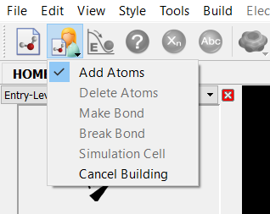
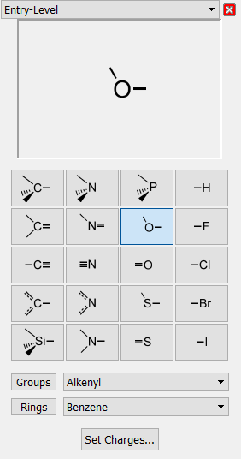
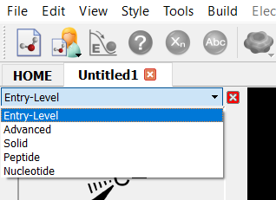
Entry-Level Build Panel
Building Blocks for Common Valences
(particularly for organic molecules)
oxygen
(e.g. for
H₂O)

Slide 22
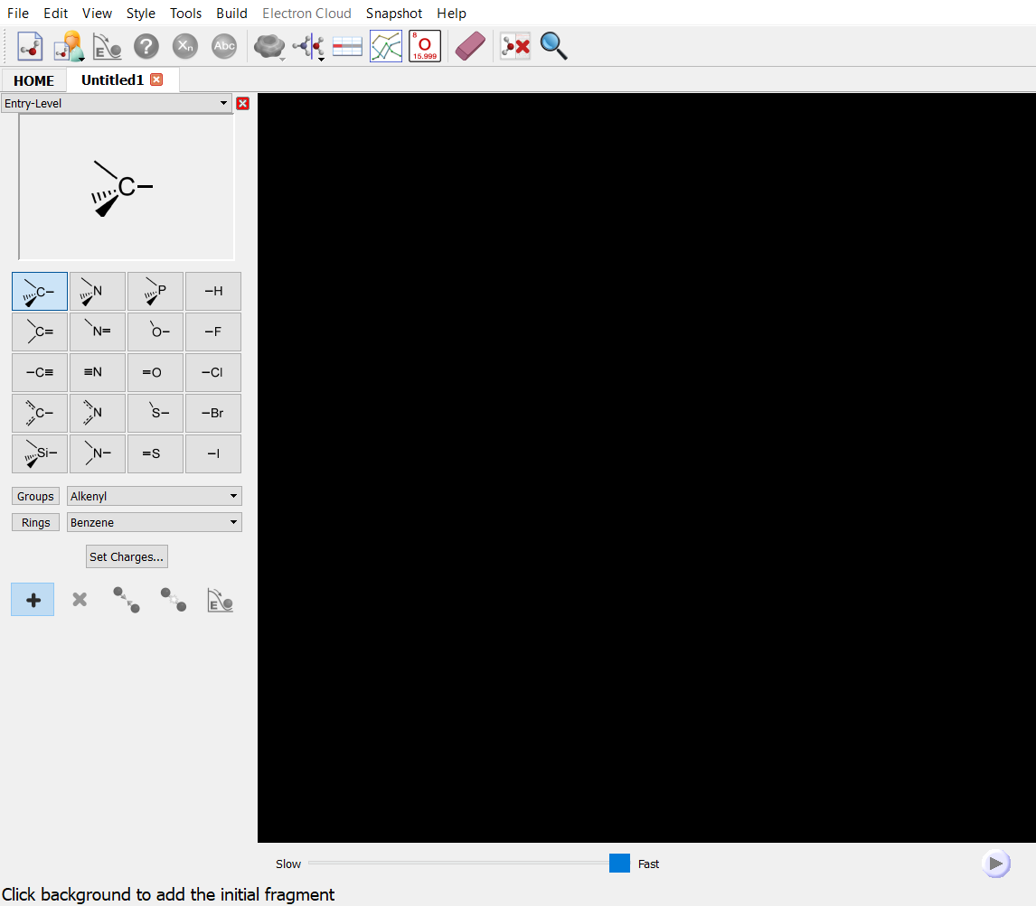
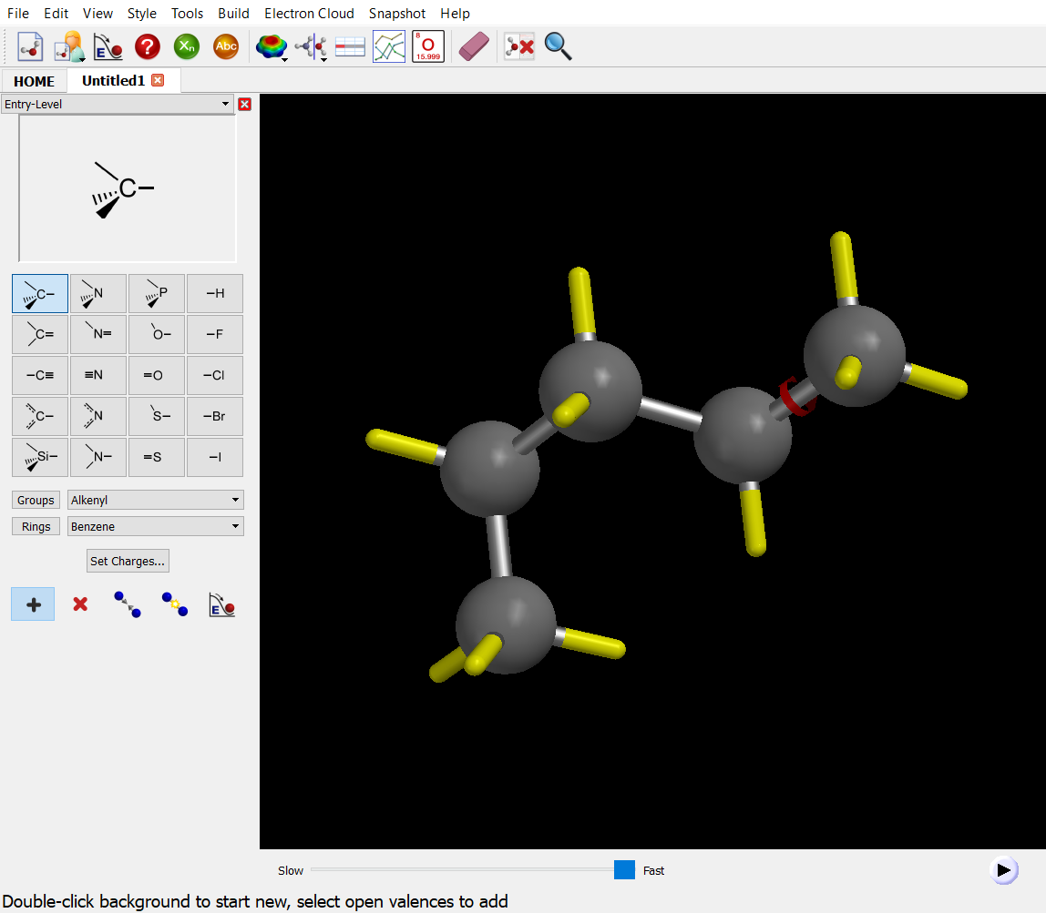
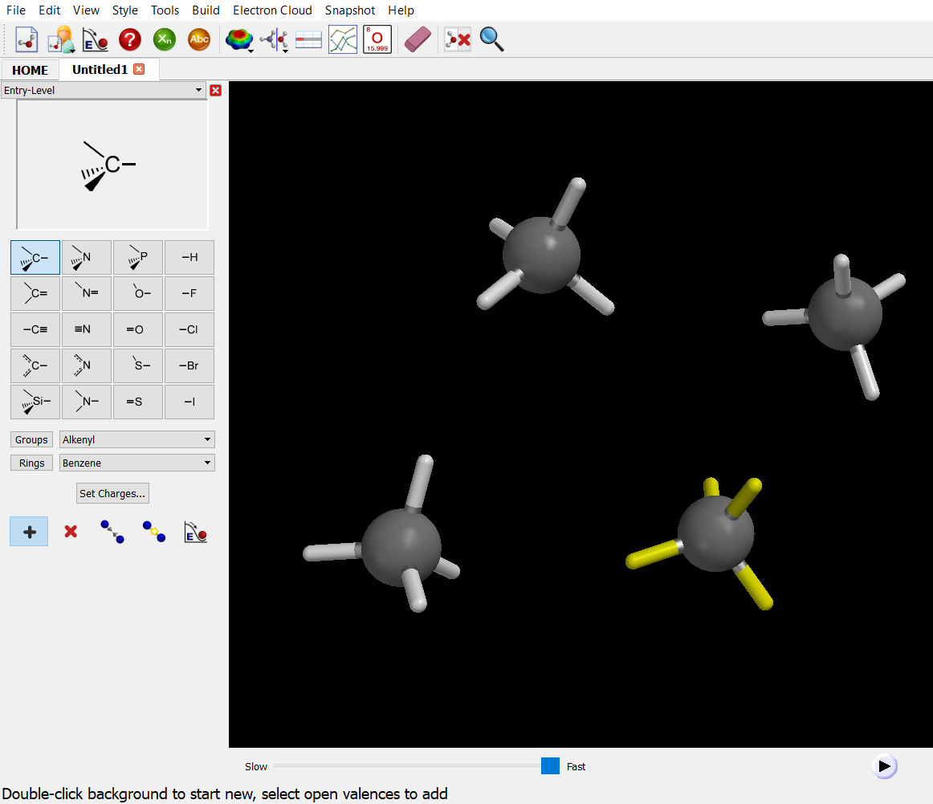
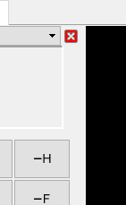
Building Molecules
Initial single click on background
→ Start molecule (first building block)
Single click on yellow spoke (free valence)
→ Continue with the same molecule
Double-click on background
→ Start new (additional) molecule
Close the build panel with its Close button
(Starting a simulation will also close the build panel)

Slide 23
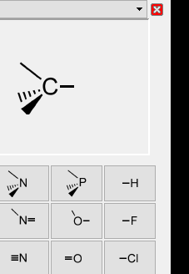
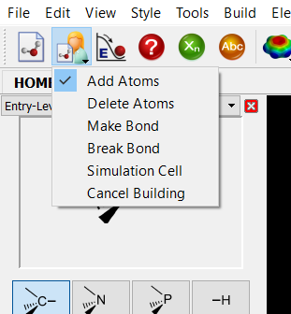
Building Molecules, Cont’d
Hydrogens can be
added manually…
…or are filled in automatically
as soon as the build panel is closed !
Deleting is modal
→ Will keep deleting until
returning to “Add Atoms” !
Always Minimize (or run a simulation )
when done building!

Slide 24
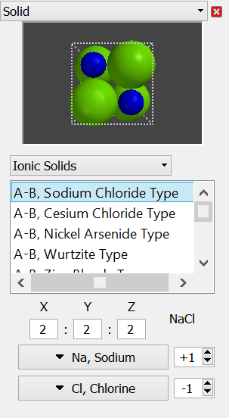
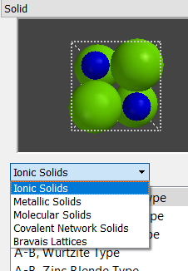
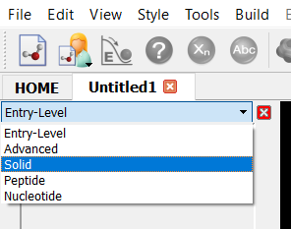
Building Solids
Template-Based
(Ionic / Metallic / Molecular / Covalent Network)
NaCl

Slide 25
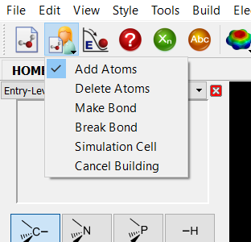
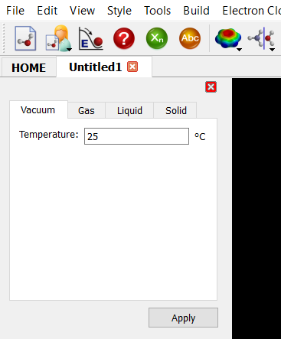
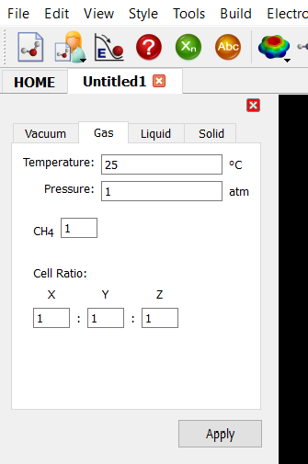
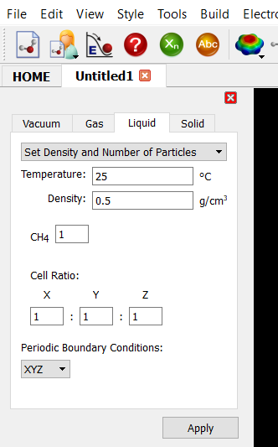
Building Liquids and Gases
Must build molecule first
(Mixture: need one molecule for each of the components)
Then use
Simulation Cell
panel
Select
Gas or Liquid
Pressure
Density
# of Molecules
Gas
Liquid

Slide 26
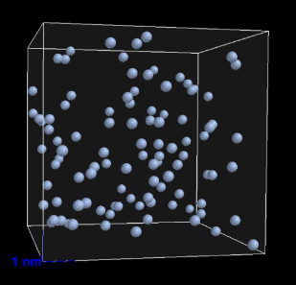
Building Liquids and Gases (Cont’d)
Don’t exceed ~1,000 atoms* total
…or things may get very slow!
Argon is excellent for
Gas Laws / Kinetic Theory
(computationally “cheap”)
Build Gases at ~10 atm (rather than ~1 atm)
→ More collisions, “better” (faster) equilibrium
Build Liquids at slightly reduced density
(such as 0.9 g/cm³ instead of 1.0 g/cm³)
→ More mobility, faster equilibrium
*atoms, not molecules

Slide 27
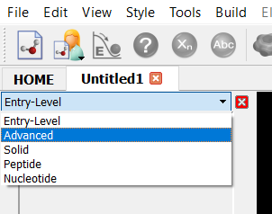
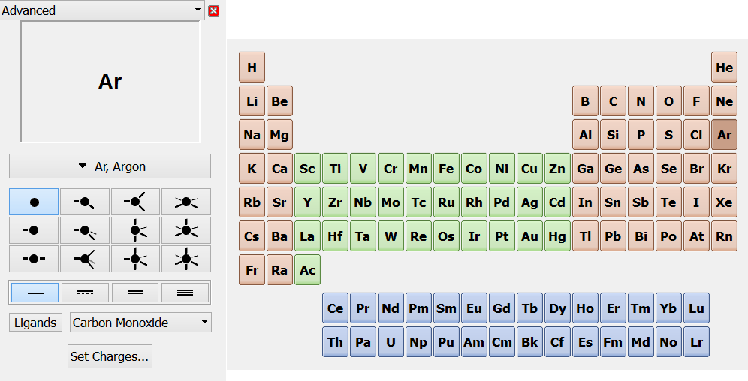
Unusual Bond Orders /
Inorganic Compounds / Complexes
Pop-Up Periodic Table
Coordination
Bond
Order
Advanced

Slide 28
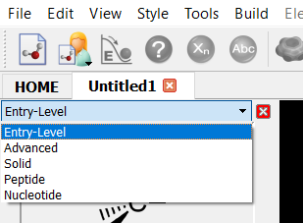
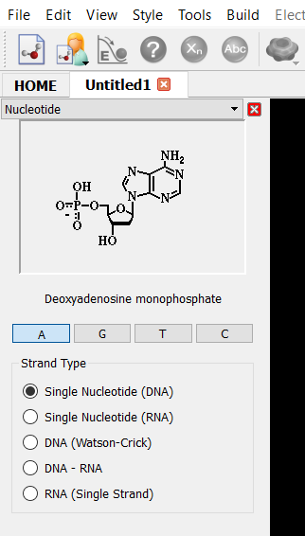
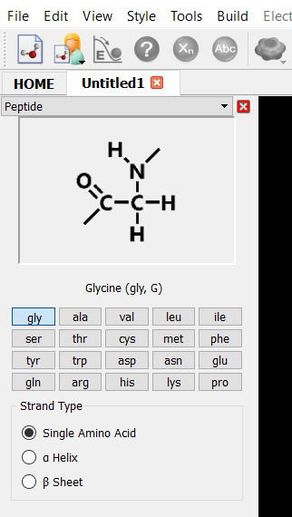
Building Biopolymers
Peptides / Oligonucleotides
Nucleotide
Peptide
Watson-Crick
DNA
α-Helix or β-Sheet
Don’t exceed ~30 amino acids / ~30 base pairs
…or things may get very slow!

Slide 29
Comparing
Showing Models Side-by-Side

Slide 30
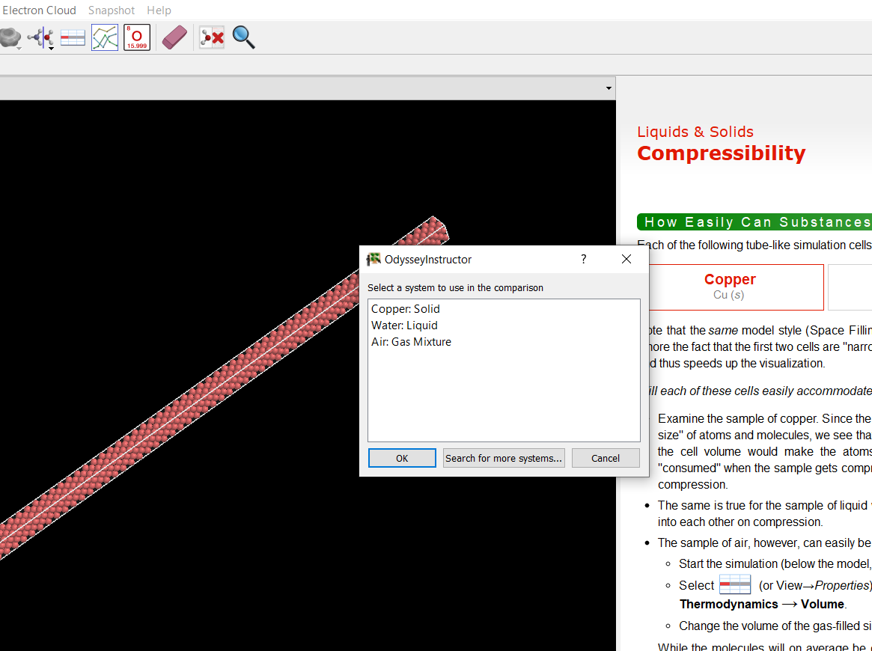
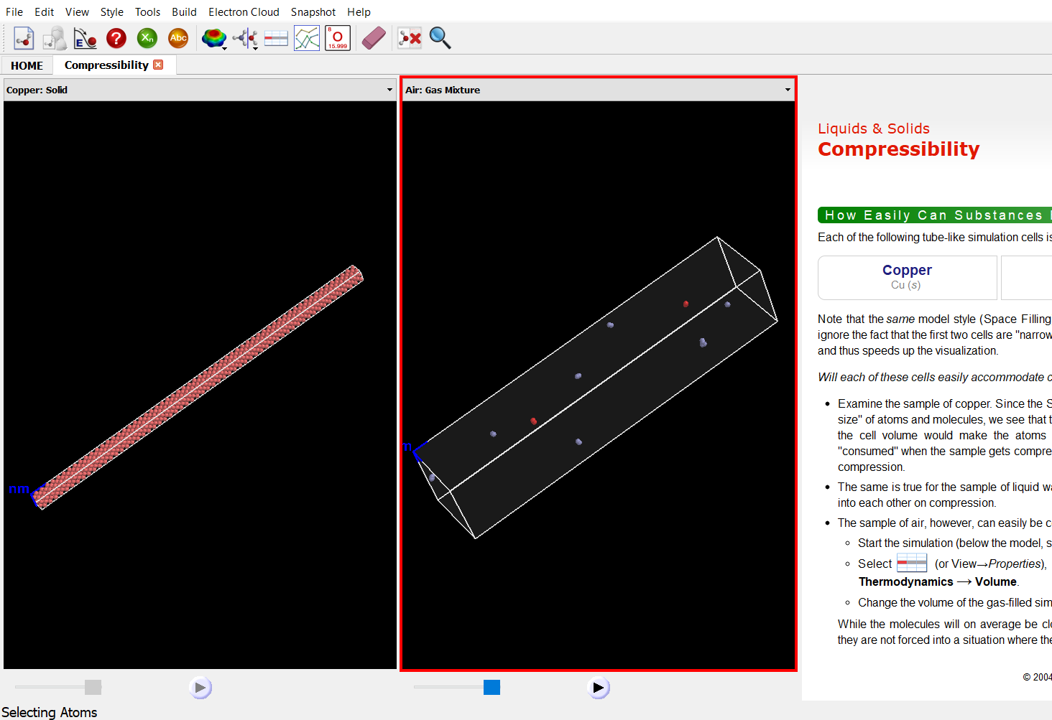
Comparing Two Models from the Same Lab
Compare
→ Side-by-Side
Models can be
manipulated
individually
Choose “active” model
(= the one with the red frame)
by selecting its background
Select second model for the comparison

Slide 31
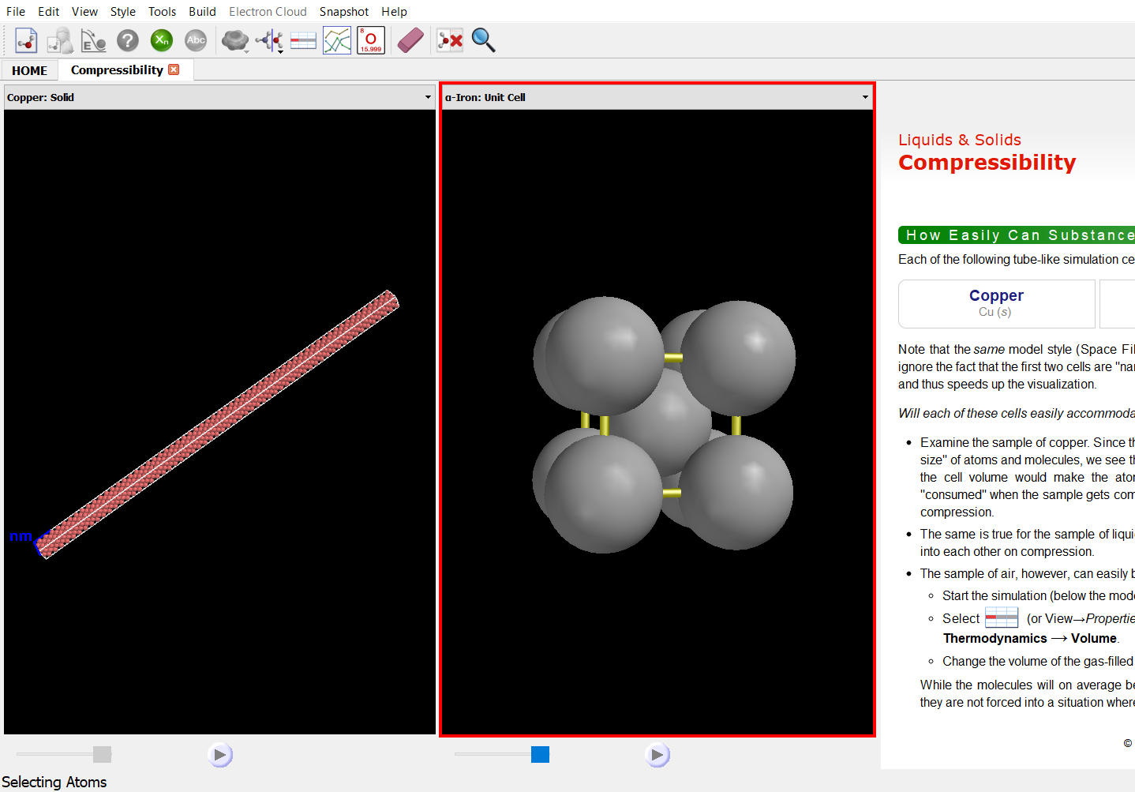
Getting the Comparison Model via Search
Compare
→ Side-by-Side
Available for comparison:
~2,000 models
Search for
more systems
Select second model for the comparison

Slide 32
Comparing Two User-Built Models
Build the first model…
Suitable even for…
simulation cells
independent dynamics
of both models
independent electron
cloud calculations
of both models
…keep the build panel open !
(if already closed, you must reopen
it with Build → Add Atoms)
Modify the second model,
finally close the build panel
(Note: Cannot reopen panel once closed)
Duplication
Step
[ The hydrogens of the
second model will turn
into yellow spokes as
soon as a new building
block is selected ]

Slide 33
Comparing Two User-Built Models (Cont’d)
Alternate Method
(for Two Molecules)
Comparison of two simulation
cells is not possible
Any dynamics applies to the
interacting dimer (!), not the
two molecules independently
Any calculated electron cloud
represents the dimer (!),
not the two molecules
independently
Build the first molecule…
…and simply add
another molecule
to the same model
(double-tap/double-click
on background to start
the second molecule)
Close the
build panel

Slide 34
Running Two Simulations at Once
Compare → Synchronize
Calculating the dynamics of
two systems at once invariably
probes the limits of computational
power → expect slow simulations
→ Single (!) dynamics
toggle for both simulations
(both simulation progress at
the same physical speed)

Slide 35
Scientific Content
New Users / Labs / Stockroom

Slide 36
New Users
(Startpage upon Installation)
Step-by-Step
Instructions for
Building Models
(≈ 30 Examples)
ODYSSEY in
≈ 30 Short Lessons

Slide 37
Labs
(Learning Units for ≈ 300 Topics)

Slide 38
Stockroom
(Molecular Models for ≈ 800 Elements / Compounds / Mixtures)
Shortcuts
(Select Individual
Compounds)
Collections
(Multiple
Compounds)

